Slide 1
WebEx Discussion Format
All attendees will be on mute upon entry to the Webinar
Questions will be entertained during the discussion when the PSEG Long Island representative pauses and solicits questions, typically at the end of each topic
Click the ‘Raise Hand’ button to request to speak
If your question has been answered click again to remove request
PSEG Long Island will conduct the presentation that is anticipated to last about an hour
The presentation will be followed by an open question period
The WebEx may extend beyond the 2-hour limit if needed
Questioners may announce themselves or remain anonymous
The presentation deck will be posted on the RFP website following the WebEx

Slide 2
Western Nassau RFP WebEx
February 11, 2016

Slide 3
Agenda
PSEG Long Island Team Introductions
Disclaimer
Western Nassau RFP Background and Goals
Selected RFP Discussion Topics
Communications
Product Definition
Contract
Pricing
Submittal Fees
Evaluation Process
Post-selection Process
Other
Keys to a Successful Proposal
Schedule
Western Nassau RFP WebEx; February 11, 2016

Slide 4
PSEG Long Island Team Introductions
James Parmelee, Senior Manager of Power Resources and Contracts
Ed Petrocelli, Manager of Power Projects
Steve Cantore, Manager of Power Asset Management
Anie Philip, Manager of Transmission Planning
Lucyna Khazanovich, Manager of Fuel and Power Planning
Dylan Dreisch, Engineer - Transmission Planning
Mike LiPetri, Engineer–Efficiency and Renewables Planning and Evaluation

Slide 5
Disclaimer
This WebEx is being conducted for informational purposes only and information, data, or comments provided by PSEG Long Island during the WebEx are not to be construed as altering, modifying or replacing the requirements or contents of the Western Nassau RFP. PSEG Long Island’s agreement to make material or non-material changes to the RFP arising from WebEx discussions should not be considered binding unless and until such changes appear in an addendum to the RFP. RFP Respondents are encouraged to carefully read and adhere to the Proposal requirements as articulated in the RFP and in written addendums thereto.

Slide 6
Western Nassau RFP Background and Goals
Western Nassau, defined as the Far Rockaway and Glenwood load areas, requires upgrades to meet NERC Reliability Standard TPL–001–04.
Upgrades could be a LIPA transmission solution or power production and load reduction resources.
Upgrades must be in place by December 31, 2020.
Procurement open to all technologies (e.g., conventional generation, energy efficiency, demand response, distributed energy resources, energy storage, and renewables).
Respondents must submit Proposals that offer a complete solution, i.e., a Proposal that meets the minimum resource requirements at either or both locations.
Respondent Proposals may include multiple parties, but one party will be required to be the contracting entity and responsible for performance of the Proposal.

Slide 7
Western Nassau RFP Background and Goals (con’t)
Total resource requirements
Far Rockaway: 160 MWs by year end 2020, increasing to 275 MWs by 2030
Glenwood: 100 MWs by year end 2020
Minimum amount of resource types
Far Rockaway: 140 MWs of power production resources by YE 2020 increasing to 240 MWs by 2030
Balance of requirement may be met by power production or load reduction resources but they must meet service delivery hour target and energy requirements (explained in further detail in slide 10)
Glenwood: 75 MWs of power production resources by YE 2020
Balance of requirement may be met by power production or load reduction resources but they must meet service delivery hour target and energy requirements (explained in further detail in slide 10).

Slide 8
Western Nassau RFP Background and Goals (con’t)
Power production resources will connect to the Far Rockaway or Glenwood 69 kV bus
Interconnection costs at Far Rockaway are estimated at between:
$45 million - $75 million for 171 MWs - 275 MWs.
$55 million - $90 million for 276 MWs - 301 MWs
$65 million - $100 million for 311 MWs – 339 MWs
No current estimate for Glenwood interconnection costs, but:
Installation of power production resources greater than 225 MWs may necessitate investment in additional transmission reinforcements
Transmission solutions at both locations are alternatives. Estimated costs of transmission solutions:
Far Rockaway: $127 million - $190 million
Glenwood: $170 million - $250 million

Slide 9
Selected RFP Discussion Topics: Communications
State law restricts communications during the RFP process, improper communications may result in bid disqualification.
All questions and clarifications unrelated to interconnection inquiries concerning the RFP Documents may be electronically submitted through the RFP website at http://www.psegliwnrfp.com/QandA.html.
Answers along with the questions will be available on an anonymous basis to all registered users.
The request for proprietary treatment will be evaluated and dispositioned by PSEG Long Island.
Prior to any interconnection inquiries or discussions an NDA must be executed between Respondent and PSEG Long Island. The NDA is located on the RFP website. In order to receive certain sensitive data a Critical Energy Infrastructure Information Request will need to be completed.
PSEG Long Island contact information is provided in the RFP.

Slide 10
Selected RFP Discussion Topics: Product Definition
Technologies may include conventional generation, energy efficiency, demand response, distributed energy resources, energy storage, and renewables.
Power production resources must meet the requirements and specifications described in Appendix B. For example:
The minimum amount of power production resources must be available all hours and all days in a year without any limitations to specific hours in a day.
Load reduction resources must meet the roles and responsibilities and requirements and specifications as described in Appendix A. For example:
Operating Months must include May 1st through October 31st.
Availability Days must include all days of the week.
Service Delivery Hours must cover, at a minimum, a 6-hour consecutive period within the 10-hour period between 12:00 PM and 10:00 PM Eastern Prevailing Time (EPT). Time of reduction to be controlled by PSEG Long Island.
The energy requirement of the load reduction resource must equal the peak demand reduction multiplied by the required duration and multiplied by 80%.
Energy storage may be proposed as a peak shaving device under the load reduction specifications.

Slide 11
Selected RFP Discussion Topics: Contract
Forms of Agreement
Purchase Power Agreements (“PPAs”) between LIPA and the selected Respondents for projects that employ power production resources, or
Service Contracts between PSEG Long Island and the selected Respondents for projects that employ load reduction resources
Potential for up to three (3) agreements for a single Proposal: one for dispatchable power production resources; one for non-dispatchable power production resources; and one Service Contract for load reduction technologies.
For Proposals that require multiple agreements, such agreements will contain cross default provisions so that a default on any one of the agreements would potentially result in a default on all of the agreements covered by the Proposal.
Term of Agreement: through December 31, 2039

Slide 12
Selected RFP Discussion Topics: Pricing
All proposed contract pricing must be firm and all terms and conditions must be open for acceptance through January 31, 2018.

Slide 13
Selected RFP Discussion Topics: Submittal Fees
Submittal fee - $1/kW per Proposal.
Respondents may submit separate Proposals for complete solutions at Glenwood and Far Rockaway.
Respondents may submit multiple Proposals for complete solutions for either location, but each Proposal will be evaluated independently and will require separate submittal fees.
Submittal fees will be returned if Proposals are
Not submitted in timely manner
Incomplete or non-responsive
Not selected and approved by the Trustees
Proposal fees will be returned in a timely manner shortly after the completion of each evaluation phase and no interest will be paid on refunded amounts.

Slide 14
Selected RFP Discussion Topics: Submittal Fees (con’t)
Unrecovered Proposal evaluation costs will be recovered from Respondents with executed contracts via lump sum payments at the start of each contract
Payments associated with individual contracts will be in proportion to the MW size of the contract relative to the total MWs procured via the RFP
Each Project contract will be allowed an adder for the first five years of the contract to recover the lump sum payment
The adder will be calculated as the lump sum payment divided by 60 months

Slide 15
Selected RFP Discussion Topics: Evaluation Process
A three-phased Proposal evaluation process, based on New York State Comptroller requirements, will be employed:
Phase 1: Determine the responsiveness of each Proposal with a “pass/fail” designation.
Phase 2: Consists of an initial qualitative review of all of the criteria in the RFP as well as a levelized cost analysis of each individual Proposal or Proposal option.
Phase 3: Consists of all-in cost quantitative analysis, enhanced qualitative analysis and cost of system upgrades for each Proposal.
Those Proposals that are found to be superior in Phase III will be submitted to the LIPA Board of Trustees as PSEG Long Island’s suggestions for Proposals that should proceed to contract negotiations.

Slide 16
Selected RFP Discussion Topics: Post-Selection Process
Upon selection by the Board of Trustees, PSEG Long Island and the selected Respondent(s) will negotiate service contracts and PPAs. The redlined PPAs submitted with the Proposal will be the starting point for negotiations.
Service Contracts may be executed by PSEG Long Island after completion of negotiations.
Negotiated PPAs shall not be binding until approved by LIPA’s Board of Trustees, the NY State Attorney General and the NY State Comptroller.
PPAs may not be executed by LIPA until the LIPA Board of Trustees authorizes execution.
For projects requiring SEQRA approval, Trustees may not vote to authorize execution until such approval has been received and documented.
For projects subject to Articles 7 or 10 of New York Public Service Law, a condition precedent to the PPA becoming effective is that the Respondent must receive a certificate of environmental compatibility and public need.

Slide 17
Selected RFP Discussion Topics: Other
LIPA is not offering property for sale or use for any project with the exception of substation property that is required for the interconnection of those projects in accordance with the LGIP or the SGIP.

Slide 18
Keys to a Successful Proposal
Proposal received by May 13, 2016, 3:00 PM EPT deadline
Proposal delivered with required submittal fee as a certified check or bank check made payable to PSEG Long Island
All required documents and forms supplied with proposal
No material changes after submittal of the proposal
Firm pricing through January 31, 2018
Prompt response to clarifying questions posed by PSEG Long Island
Initial power delivery must be no later than December 31, 2020

Slide 19
Keys to Successful Proposal (con’t)
Community acceptance
Documented evidence of local outreach and support from the local community, including elected officials and civic groups
Required permits in hand or demonstration with a reasonable degree of confidence that such permits can be obtained
Competitively priced (including fuel pricing as required by Section 3.2.4.1.e of the RFP)
Experienced team
Respondent has demonstrated experience in developing projects of similar size, technology and scope
Ability to implement

Slide 20
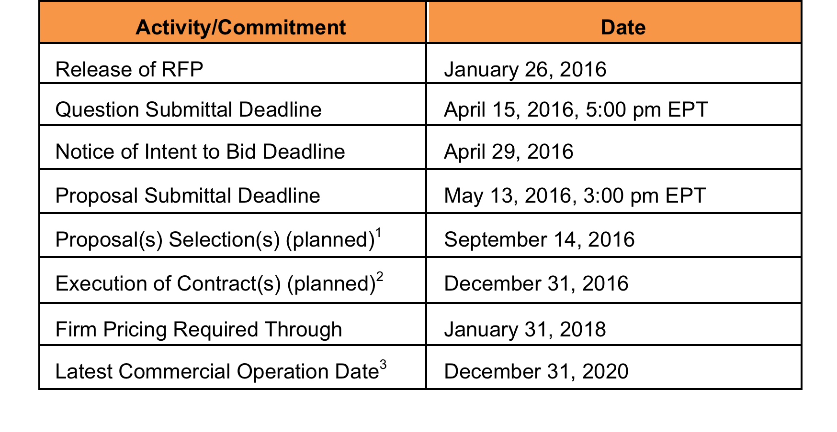
Schedule
¹ All Respondents will be notified in writing once the selections are completed.
² Execution of a contract is dependent upon completion of negotiations, and for resources requiring SEQRA, it is also dependent upon receipt of SEQRA findings.
³ All Respondents must commit to meeting the minimum resource requirements needed for compliance by year-end 2020 in either or both the Far Rockaway or Glenwood Load Areas, as described in Section 1.4. In addition, for Far Rockaway, Proposals that contain resources that will be phased in service over the term of the contract must commit to meeting the minimum resource requirements for year-end 2020 as well as the yearly total resource requirements between 2021 and 2030 that are identified in Table 1-1 in the RFP.

Slide 21
Additional questions?

